Slide 1
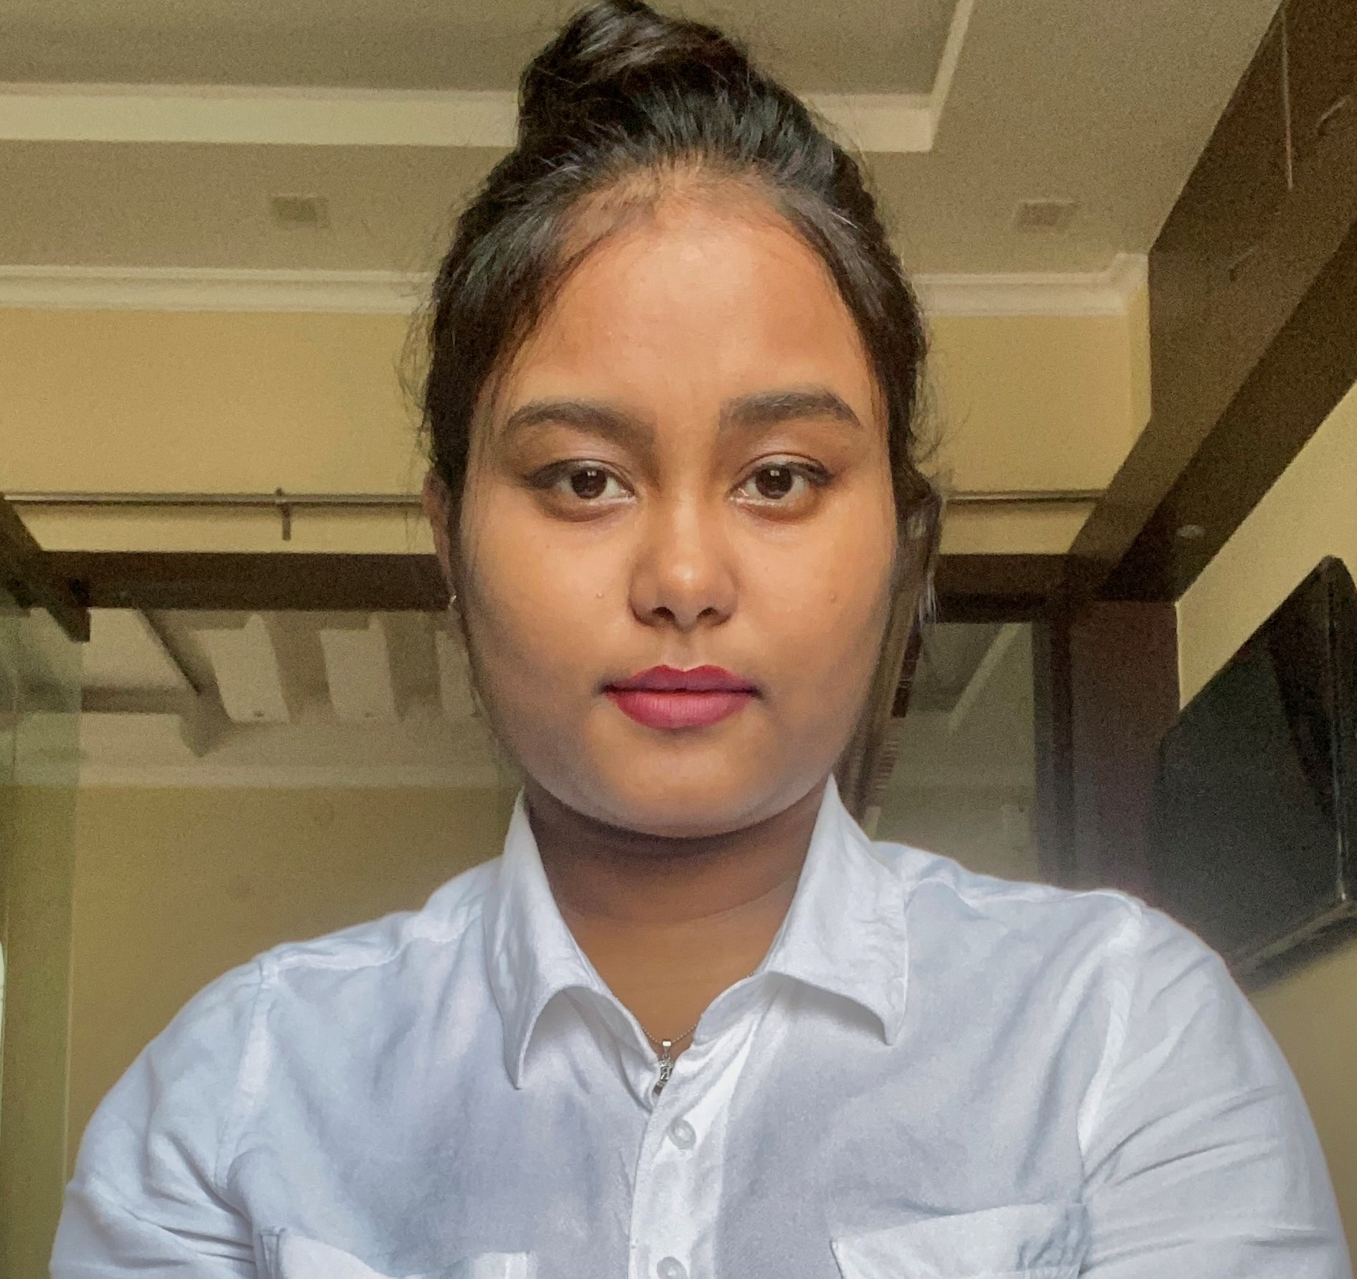
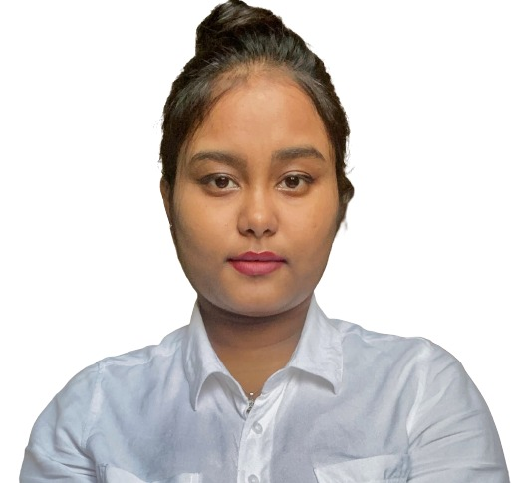

Ridhima Debnath
Analyst/Software Engineer
Bachelor of Technology,
Computer Applications : 2017-2020
Masters of Technology,
Computer Applications : 2020-2022
I Transform L&D Left shift batch
MUMBAI
ridhima.debnath@capgemini.com
Skills
+91 7098327661
C# | Basics, OOPS, Exception Handling.
.NET Framework | ADO.NET,ASP.NET with MVC5 and WEB API, Entity Framework
C | Basic Concepts
Database | SQL
Tools | GIT,POSTMAN
UI Technology | Angular & HTML5 ,CSS
Add On Skills | Communication Skills, Ability to perceive, Team Management
Full Stack Developer
Understanding of RDBMS concepts using SQL Server.
Practical understanding of C# and SQL concepts using Visual Studio and SQL Server
Hands on experience in developing applications using .NET Framework, ASP.NET Core
Understanding of Angular CLI and HTML5 , CSS .
Completed case study on Online Shopping Cart System which is a Web-based System. To automate Product purchase from converting the shopping system from manual to online and to meet the requirements and expectations of diverse customers this system is built where online shopping has always been useful for everyone . This system saves and reduces the manual work of the users. Customers can register to this site or login if already registered and select the items and add to cart and purchase the products finally from the site.
Technologies used:
ANGULAR
ASP.NET CORE
Microsoft SQL Server
Video Link: Click
Github Link

